Slide 1


Evaluating Traditional and Neural Network Models for Risk Prediction
EAI 6010
Professor Sergiy Shevchenko
Wenli Hu
Junhui Hu

Slide 2
Porto Seguro: Dataset & Problem Setup
Binary classification: predict insurance claim risk
595,212 observations, 59 anonymized features
Mixed feature types: continuous, binary, categorical
Severe class imbalance (~96% non-claim)

Slide 3
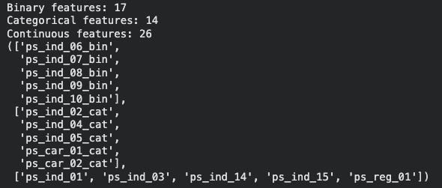
Feature Types & Data Challenges
Features grouped by suffix:
-- Continuous
-- Binary (_bin)
-- Categorical (_cat)
Missing values encoded as −1
Anonymized features → no manual feature engineering

Slide 4
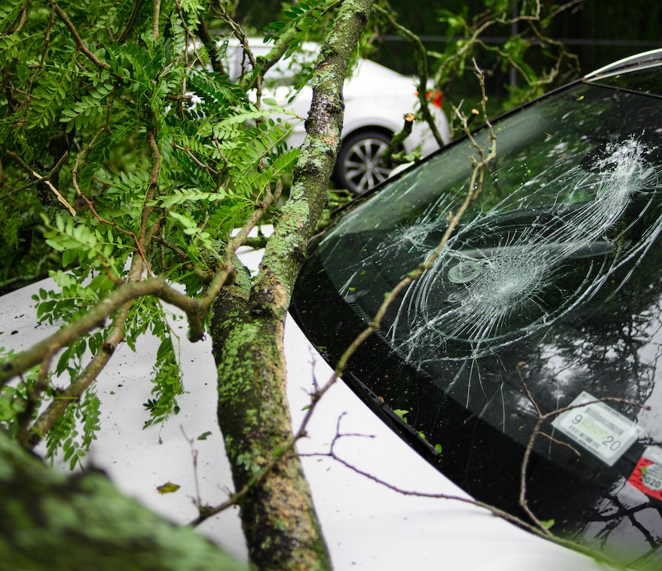
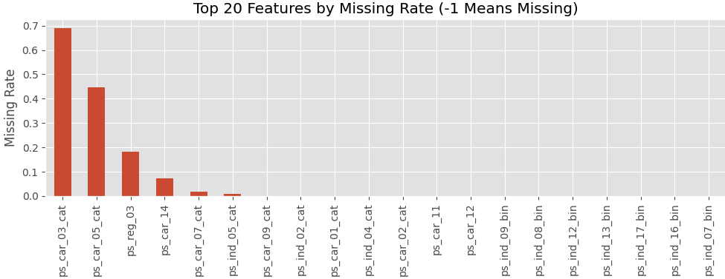
Missing Value Patterns
Feature-wise missing rate computed
ps_car_03_cat has ~70% missing
Extremely sparse features removed
Features with extremely high missingness were dropped to avoid introducing noise or instability into downstream models.

Slide 5
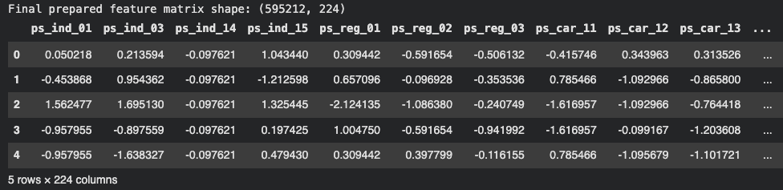
Preprocessing Pipeline
Continuous features:
−1 → NaN → median imputation
Standardized (z-score)
Binary features:
Rare −1 → mode
After preprocessing, the dataset is fully numeric, scaled, and ready for both classical models and neural networks.
Categorical features:
−1 kept as “unknown”
One-hot encoded

Slide 6
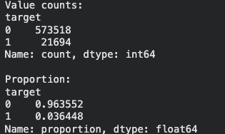
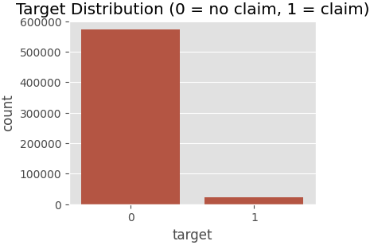
Target Distribution & Metric Selection
~96.4% target = 0
~3.6% target = 1
Accuracy is misleading
AUC better reflects discrimination ability

Slide 7
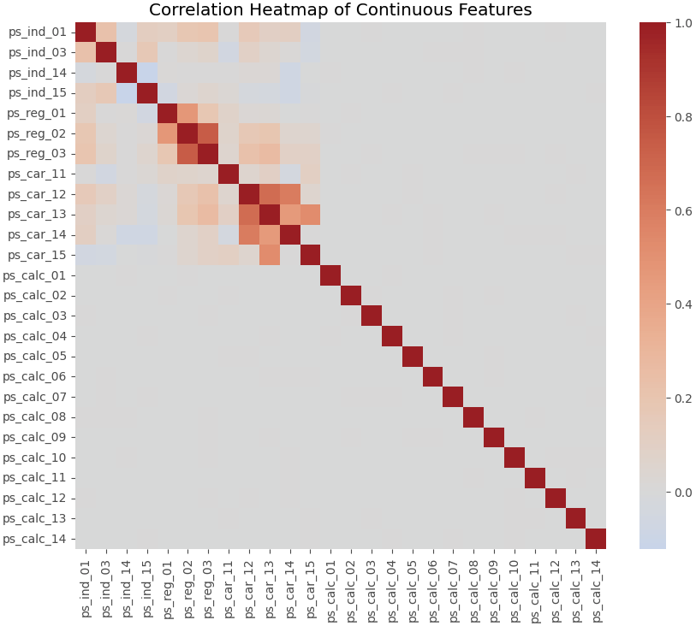
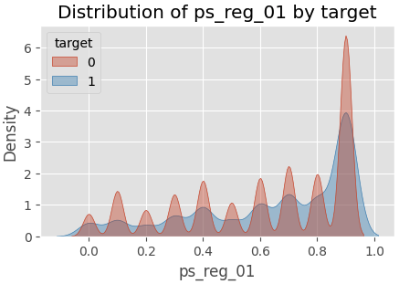
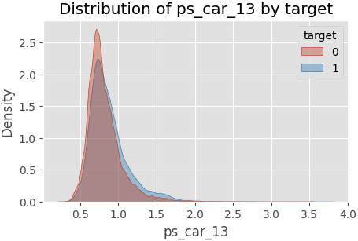
Correlation & Feature Distributions
Correlation heatmap shows several clusters among continuous features
Indicates potential redundancy and interactions between variables
Single features alone are not sufficient, but still provide useful signal

Slide 8
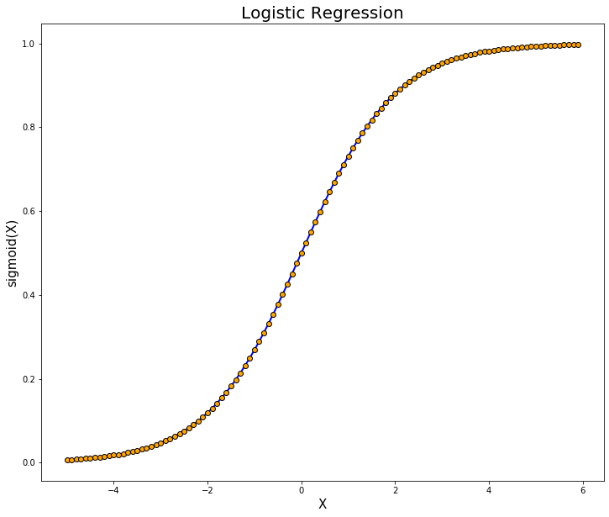
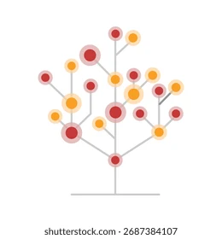
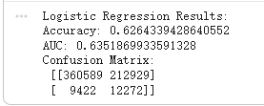

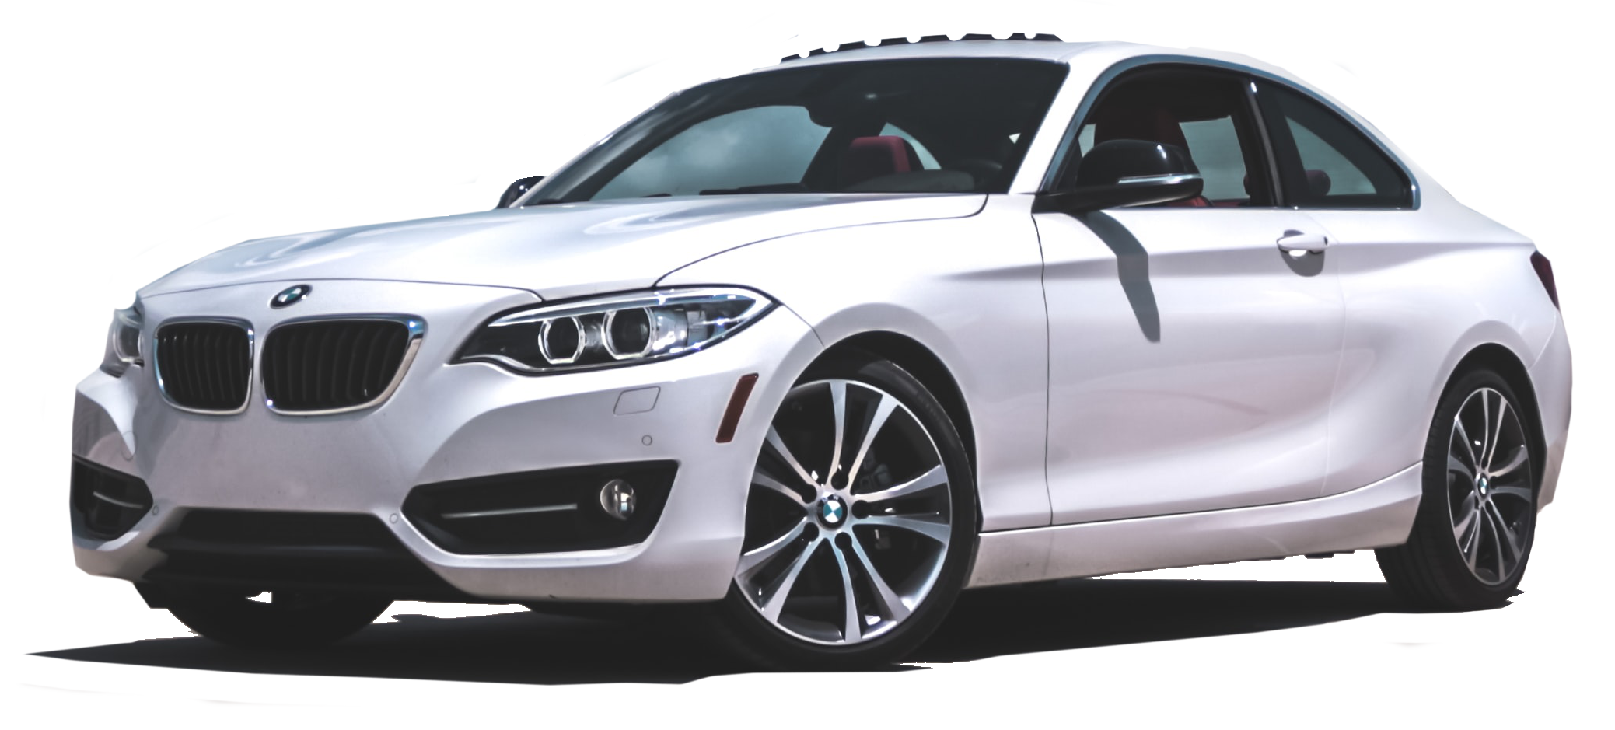
Baseline Models
Logistic Regression AUC ≈ 0.63
Decision Tree AUC ≈ 0.62
Accuracy misleading due to imbalanced labels
AUC chosen as primary metric
Logistic Regression
Decision Tree
Notes:
We began with logistic regression and a decision tree. They are simple, interpretable models, so they’re good for understanding the dataset. Both models had an AUC of about point six one. At we told before we thought the low accuracy meant the models were bad, but as my teamate findout in EDA almost all labels are zero. That means predicting zero for everything already gives around ninety-six percent accuracy.
for imbalanced datasets, accuracy is almost meaningless. That’s why we used AUC as the main evaluation metric. Once we did that, it became clear that both baseline models performed similarly and weren’t capturing deeper patterns.

Slide 9
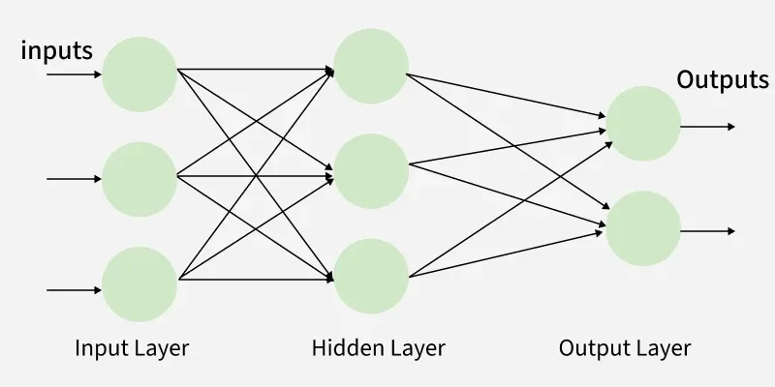
Why Use an MLP?
Dataset features are anonymized
Manual feature engineering impossible
Need nonlinear model
MLP learns hidden interactions automatically
Notes:
Although neural networks are often associated with image, audio and text applications, they are not limited to those domains. When the features are complex, anonymized or have nonlinear interactions, neural networks can also be effective for tabular prediction tasks. In our insurance classification problem, an MLP provides a flexible way to learn hidden patterns that traditional models may miss. So Our demo is a simplified version of our full pipeline. Instead of building a visual interface, we provide a runnable notebook that walks through the key steps of our workflow for you to download.
Back to MLP we used the components we learned in class: Rectified Linear Unit activations, dropout to reduce overfitting, and binary cross-entropy with logits as the loss function. Even a simple one-hidden-layer MLP improved the AUC to around point six three or point six four, which we think already better than the baseline models.
Multilayer Perceptron:a fundamental type of feedforward neural network with input, output, and one or more hidden layers of interconnected neurons that learn complex, non-linear patterns by processing data layer by layer, using activation functions (like ReLU) and backpropagation for training
Rectified Linear Unit: It's a simple threshold function: if the input is above zero, the output passes through; if below, it's zeroed out. Help model learn nonlinearity
AUC: The area under the (ROC) curve, measuring a model's ability to distinguish between classes
ROC: a graph showing a binary classification model's performance by plotting the True Positive Rate (Sensitivity) against the False Positive Rate (1-Specificity) at various thresholds

Slide 10
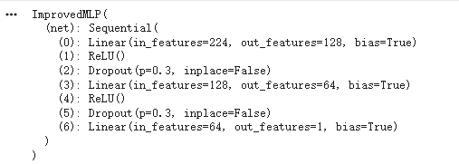
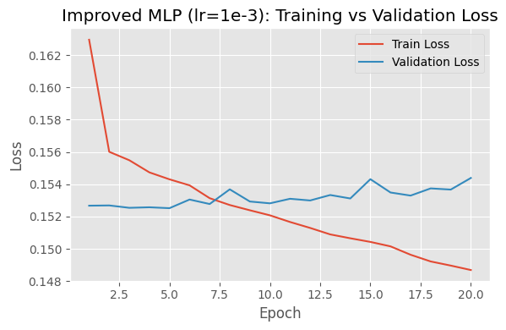
Improved MLP Architecture
However
Adding depth did NOT improve AUC
Validation loss fluctuated
Deeper not means better
Sensitivity to hyperparameters
Notes:
we then built an improved MLP with two hidden layers next: one with 128 units and one with 64. we kept dropout and Rectified Linear Unit, and trained it using Adam. The architecture looked reasonable, but surprisingly, the performance didn’t improve immediately.
This showed us deeper networks don’t automatically perform better. They are much more sensitive to the optimization process.
Even though we used dropout, the model didn’t converge cleanly, not because the model was good, because it never stabilized enough to overfit. This pushed us to investigate the optimization settings more closely.
So, we can see that the training loss keeps decreasing, so the model is definitely learning the training data. But the validation loss stays almost flat.
Validation AUC hovers around 0.63 and does not improve that much, which confirms that this deeper model with lr = 1e-3 does not really outperform the simpler baseline.
Adam: Is an optimization algorithm that automatically adjusts the learning rate for each parameter, which makes training faster and more stable, reduce noisy
Dropout: randomly turns off a portion of neurons during training, prevents the network from relying too much on specific neurons, reduce overfitting

Slide 11
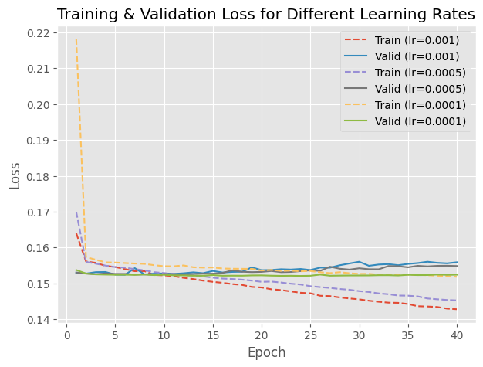
Learning Rate Experiment
We tried 3 learning rates: 1e−3, 5e−4, 1e−4
1e−3: unstable
5e−4: better
1e−4: smoothest with highest AUC
Early stopping did not trigger
Training loss kept decreasing
Notes:
The second improvement, We ran a learning rate experiment with three values this time, one-e-three, five-e-four, and one-e-four. The differences were very clear. The largest learning rate caused unstable training. The middle one was better but still inconsistent. The smallest learning rate gave the smoothest curve and the highest AUC.
We added early stopping by set patience=3 and extended training to 40 epochs. Surprisingly, early stopping never triggered for any of the three learning rates. This told us the model was not overfitting. Instead, it simply wasn't improving that much but still better than before and baseline model.
And the best AUC we get so far is 0.69

Slide 12

Future works
Explore better handling of imbalance
Tune hyperparameters more systematically
Investigate deeper or wider MLP architecture
Apply cross-validation for more reliable evaluation
Notes:
So That’s all we done for this project right now, I know theres long way to go, If we were to continue this work, there are several directions we would follow
we would look into better methods for handling class imbalance, including focal loss or class-balanced loss, which may help the model pay more attention to rare positive cases. Additionally, we would run more systematic hyperparameter search and experiment with deeper or wider MLPs using learning-rate schedulers.
And using cross-validation would give a more stable estimate，maybe？

Slide 13
Thank You
Notes:
we would look into better methods for handling class imbalance, including focal loss or class-balanced loss, which may help the model pay more attention to rare positive cases. We could also explore embedding techniques or feature selection approaches to better represent the anonymized features.
Additionally, we would run more systematic hyperparameter search and experiment with deeper or wider MLPs using learning-rate schedulers.
And using cross-validation would give a more stable estimate，maybe？

